Slide 1
Digital Imaging Fundamentals
Subhadip Basu, Ph.D.
Department of Computer Science and Engineering,
Jadavpur University

Slide 2
Contents
This lecture will cover:
  The human visual system
  Light and the electromagnetic spectrum
  Image representation
  Image sensing and acquisition
  Sampling, quantisation and resolution

Slide 3
Human Visual System
The best vision model we have!
Knowledge of how images form in the eye can help us with processing digital images
We will take just a whirlwind tour of the human visual system

Slide 4
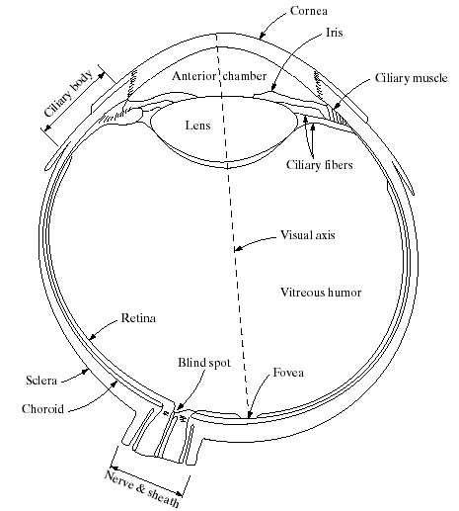

Structure Of The Human Eye
The lens focuses light from objects onto the retina
The retina is covered with
light receptors called
cones (6-7 million) and
rods (75-150 million)
Cones are concentrated
around the fovea and are
very sensitive to colour
Rods are more spread out
and are sensitive to low levels of illumination
Images taken from Gonzalez & Woods, Digital Image Processing (2002)
Notes:
Cornea and sclera keep everything in!
The choroid contains all of the blood vessels that serve as nutrition to the eye
The iris contains the pigment that gives our eyes their colour
Rods for general vison cones for details
Blind spot is where the optic nerve connects
BLIND SPOT EXPERIMENT
Women have extra cones which means they can see more colours

Slide 5
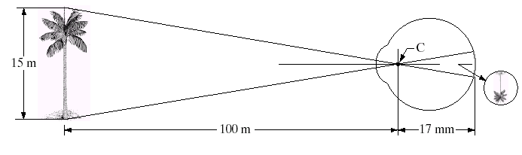
Image Formation In The Eye
Muscles within the eye can be used to change the shape of the lens allowing us focus on objects that are near or far away
An image is focused onto the retina causing rods and cones to become excited which ultimately send signals to the brain

Slide 6
Brightness Adaptation & Discrimination
The human visual system can perceive approximately 10¹⁰ different light intensity levels
However, at any one time we can only discriminate between a much smaller number – brightness adaptation
Similarly, the perceived intensity of a region is related to the light intensities of the regions surrounding it

Slide 7

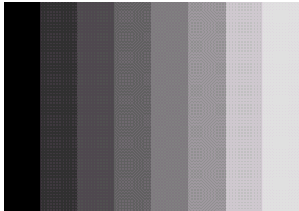
Brightness Adaptation & Discrimination (cont…)
Images taken from Gonzalez & Woods, Digital Image Processing (2002)
An example of Mach bands
Notes:
Mach bands were named after Ernst Mach who described the phenomenon in 1865

Slide 8
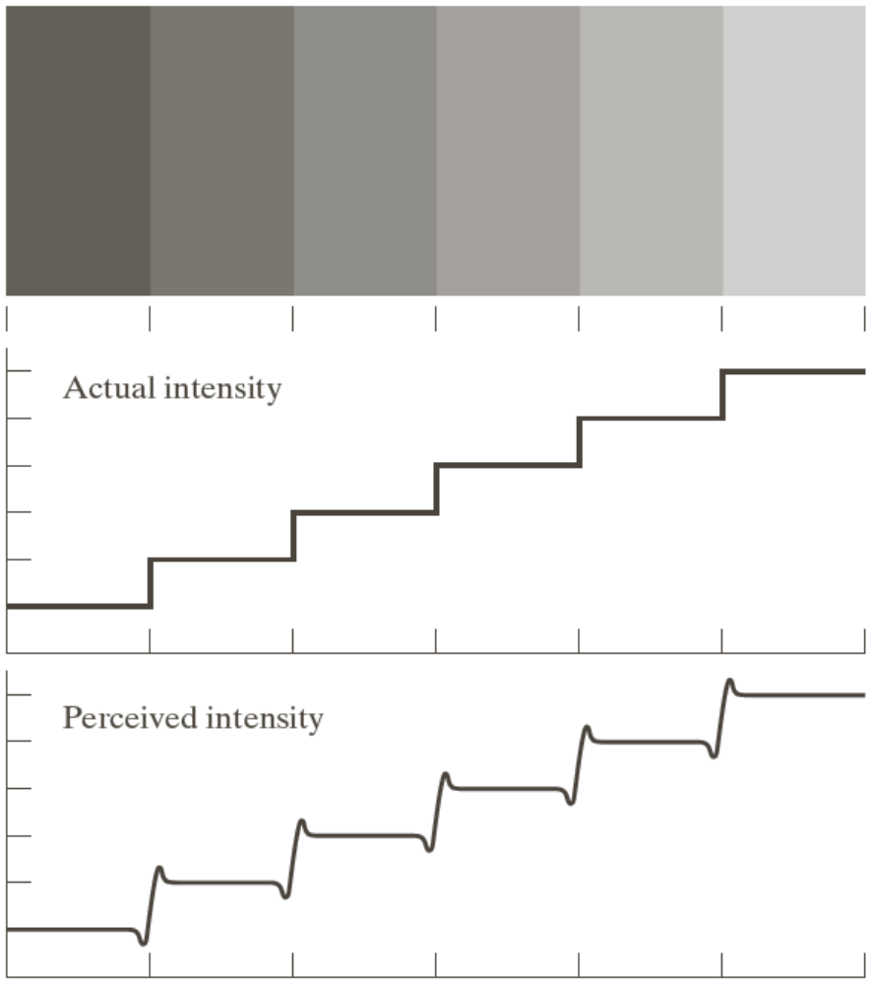
Brightness Adaptation & Discrimination (cont…)
Images taken from Gonzalez & Woods, Digital Image Processing (2002)
Notes:
Mach bands were named after Ernst Mach who described the phenomenon in 1865

Slide 9
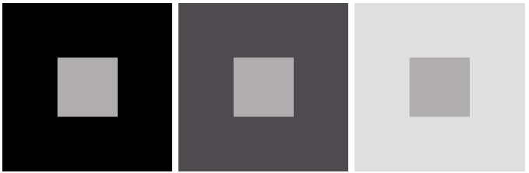
Brightness Adaptation & Discrimination (cont…)
Images taken from Gonzalez & Woods, Digital Image Processing (2002)
An example of simultaneous contrast
Notes:
Mach bands were named after Ernst Mach who described the phenomenon in 1865

Slide 10
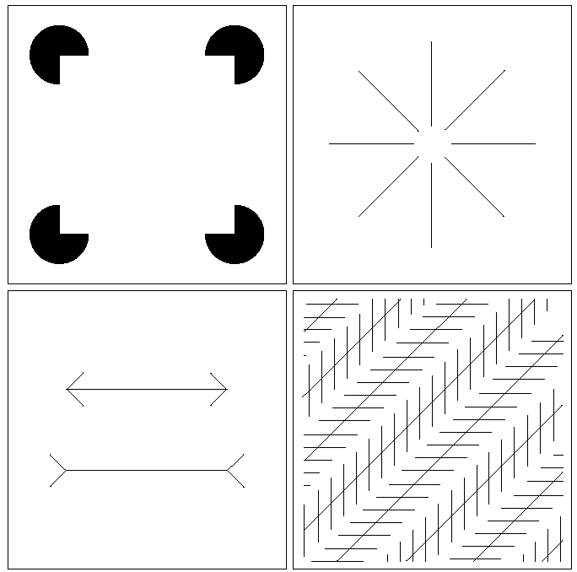
Optical Illusions
Our visual systems play lots of interesting tricks on us

Slide 11
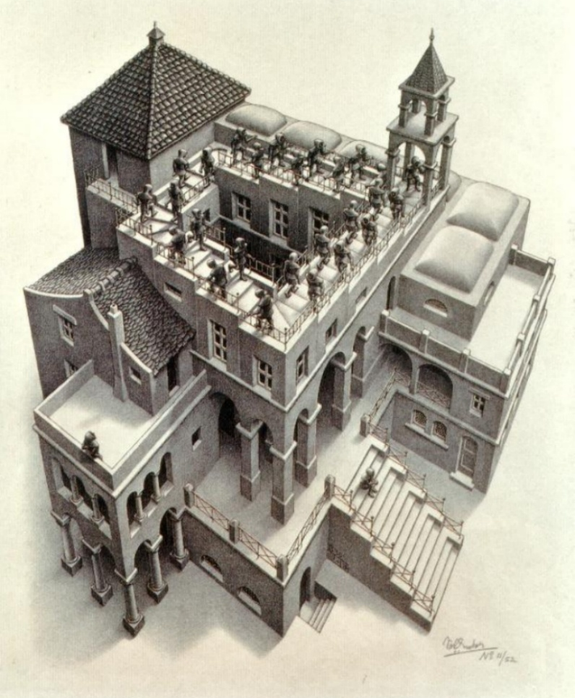
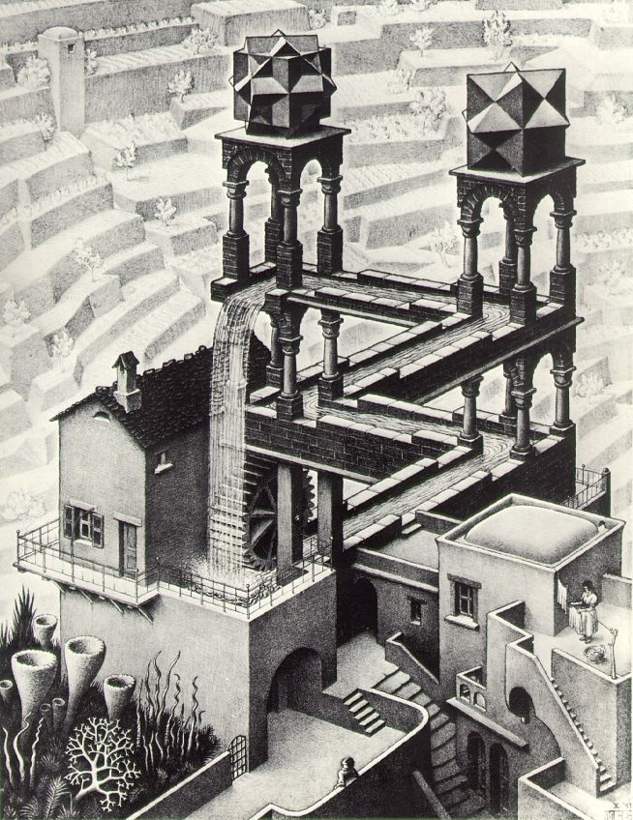
Optical Illusions (cont…)

Slide 12

Optical Illusions (cont…)
Stare at the cross in the middle of the image and think circles

Slide 13
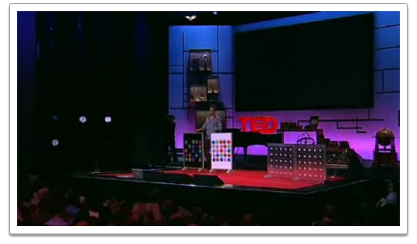

Mind Map Exercise: Mind Mapping For Note Taking
Beau Lotto: Optical Illusions Show How We See
http://www.ted.com/talks/lang/eng/beau_lotto_optical_illusions_show_how_we_see.html

Slide 14
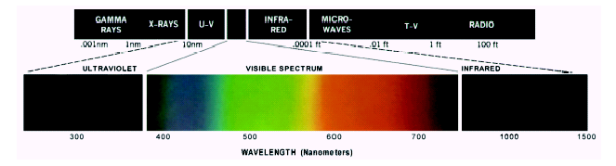
Light And The Electromagnetic Spectrum
Light is just a particular part of the electromagnetic spectrum that can be sensed by the human eye
The electromagnetic spectrum is split up according to the wavelengths of different forms of energy
Notes:
In 1666 Sir Isaac Newton discovered that light passed through a prism splits into a continuous spectrum of colours
Many image applications use electromagnetic radiation that is far outside the visual spectrum – x-ray images, infra-red images – we genrate images of these images by mapping them to the visual spectrum

Slide 15
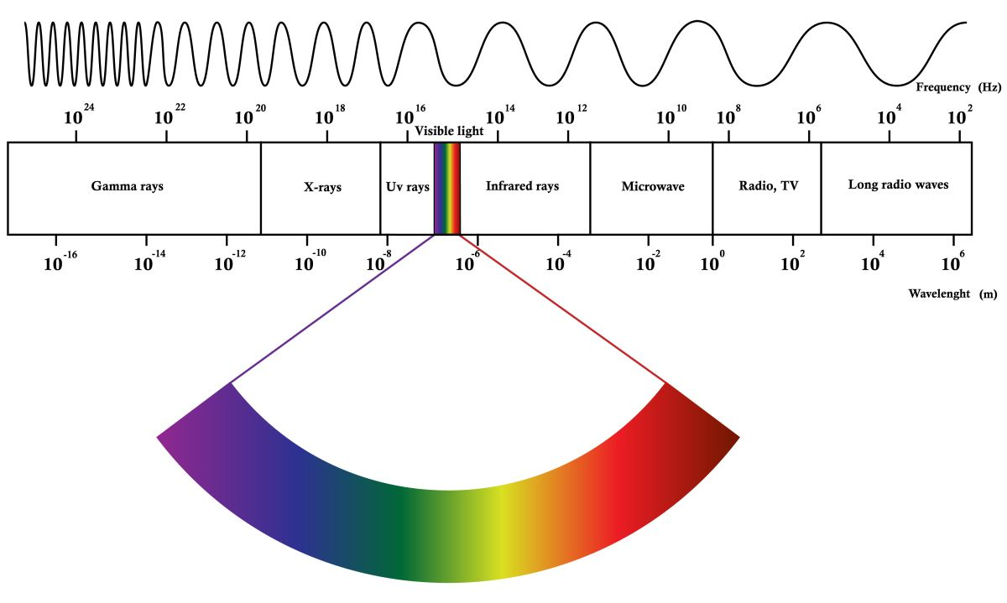
Electromagnetic Spectrum

Slide 16

Reflected Light
The colours that we perceive are determined by the nature of the light reflected from an object
For example, if white
light is shone onto a
green object most
wavelengths are
absorbed, while green
light is reflected from
the object
White Light
Colours Absorbed
Green Light

Slide 17
Sampling, Quantisation And Resolution
In the following slides we will consider what is involved in capturing a digital image of a real-world scene
  Image sensing and representation
  Sampling and quantisation
  Resolution

Slide 18
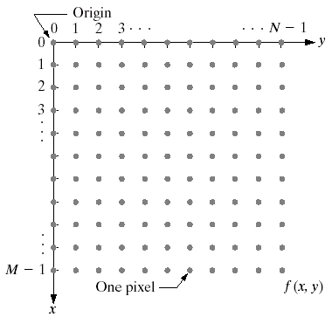
Image Representation
Before we discuss image acquisition recall that a digital image is composed of M rows and N columns of pixels
each storing a value
Pixel values are most
often grey levels in the
range 0-255(black-white)
We will see later on
that images can easily
be represented as
matrices
col
Images taken from Gonzalez & Woods, Digital Image Processing (2002)
f (row, col)
row

Slide 19

Image Acquisition
Images are typically generated by illuminating a scene and absorbing the energy reflected by the objects in that scene
  Typical notions of illumination and scene can be way off:
    X-rays of a skeleton
    Ultrasound of an
    unborn baby
    Electro-microscopic
    images of molecules
Images taken from Gonzalez & Woods, Digital Image Processing (2002)

Slide 20
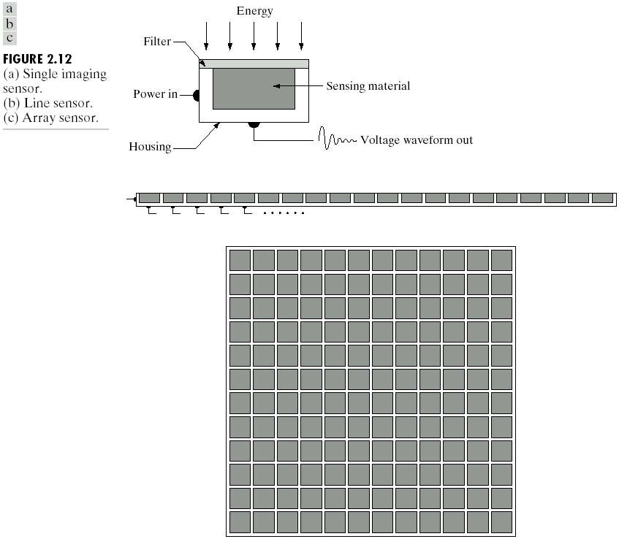
Image Sensing
Incoming energy lands on a sensor material responsive to that type of energy and this generates a voltage
Collections of sensors are arranged to capture images
Images taken from Gonzalez & Woods, Digital Image Processing (2002)
Imaging Sensor
Line of Image Sensors
Array of Image Sensors

Slide 21
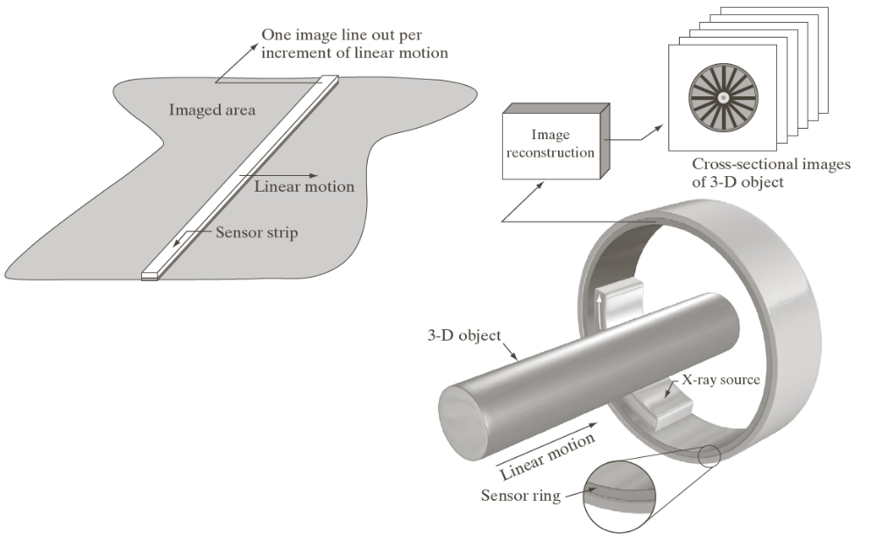
Image Sensing
Images taken from Gonzalez & Woods, Digital Image Processing (2002)
Using Sensor Strips and Rings

Slide 22

Image Sampling And Quantisation
A digital sensor can only measure a limited number of samples at a discrete set of energy levels
Quantisation is the process of converting a continuous analogue signal into a digital representation of this signal
Images taken from Gonzalez & Woods, Digital Image Processing (2002)
Notes:
Analogue Vs digital
Think of the volume knob on your stereo
Records Vs CDs Vs Mp3s
Nyquist theory etc talks about how much sampling we need to do

Slide 23
Image Sampling And Quantisation
Images taken from Gonzalez & Woods, Digital Image Processing (2002)
Notes:
Analogue Vs digital
Think of the volume knob on your stereo
Records Vs CDs Vs Mp3s
Nyquist theory etc talks about how much sampling we need to do

Slide 24
Image Sampling And Quantisation
Images taken from Gonzalez & Woods, Digital Image Processing (2002)
Notes:
Analogue Vs digital
Think of the volume knob on your stereo
Records Vs CDs Vs Mp3s
Nyquist theory etc talks about how much sampling we need to do

Slide 25

Image Sampling And Quantisation (cont…)
Remember that a digital image is always only an approximation of a real world scene
Images taken from Gonzalez & Woods, Digital Image Processing (2002)

Slide 26
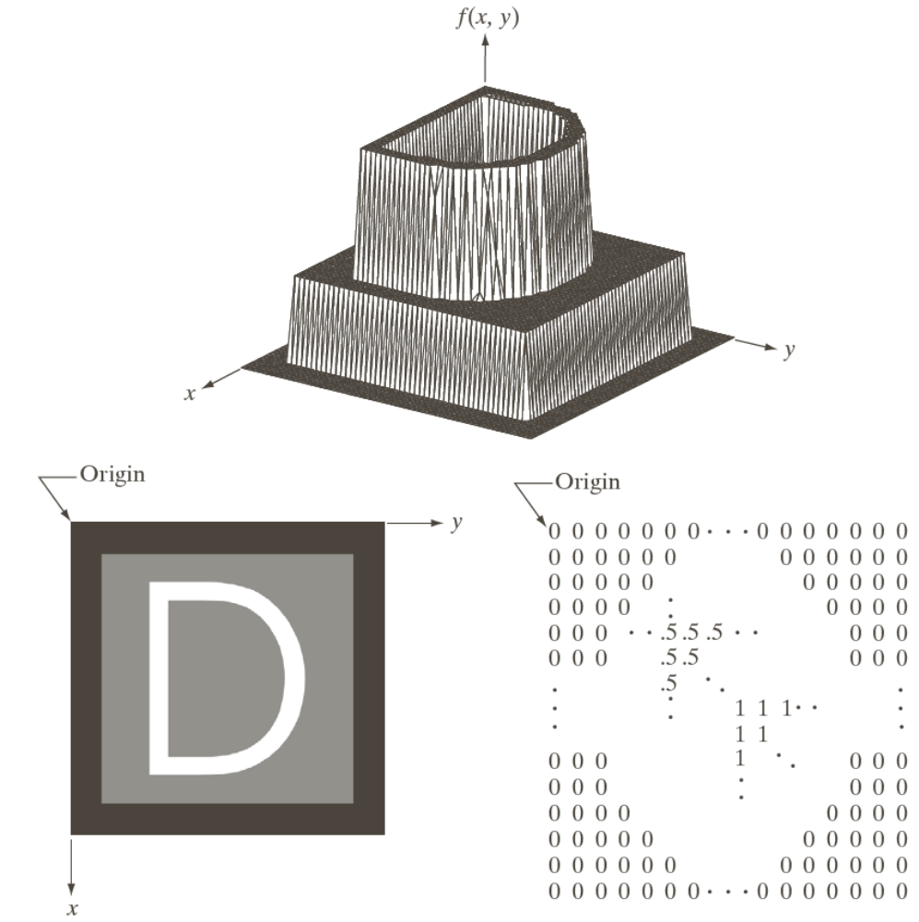
Image Representation
Images taken from Gonzalez & Woods, Digital Image Processing (2002)

Slide 27
Image Representation
Images taken from Gonzalez & Woods, Digital Image Processing (2002)

Slide 28
Image Representation
Images taken from Gonzalez & Woods, Digital Image Processing (2002)

Slide 29
Image Representation
Images taken from Gonzalez & Woods, Digital Image Processing (2002)

Slide 30
Spatial Resolution
The spatial resolution of an image is determined by how sampling was carried out
Spatial resolution simply refers to the smallest discernable detail in an image
  Vision specialists will
  often talk about pixel
  size
  Graphic designers will
  talk about dots per
  inch (DPI)
15 Megapixels

Slide 31
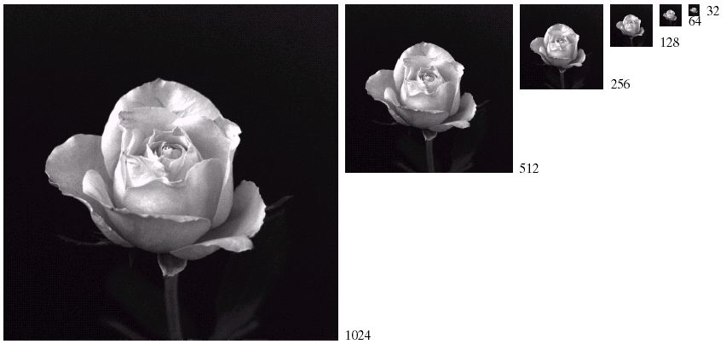
Spatial Resolution (cont…)
Images taken from Gonzalez & Woods, Digital Image Processing (2002)

Slide 32
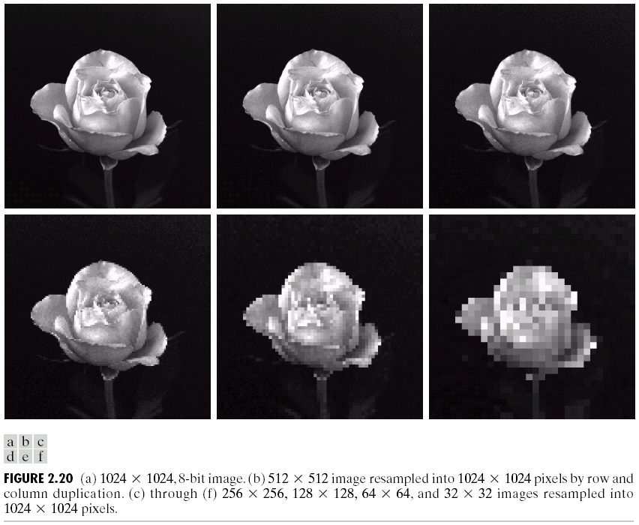
Spatial Resolution (cont…)
Images taken from Gonzalez & Woods, Digital Image Processing (2002)

Slide 33
Spatial Resolution (cont…)
Images taken from Gonzalez & Woods, Digital Image Processing (2002)

Slide 34
Spatial Resolution (cont…)
Images taken from Gonzalez & Woods, Digital Image Processing (2002)

Slide 35
Spatial Resolution (cont…)
Images taken from Gonzalez & Woods, Digital Image Processing (2002)

Slide 36
Spatial Resolution (cont…)
Images taken from Gonzalez & Woods, Digital Image Processing (2002)

Slide 37
Spatial Resolution (cont…)
Images taken from Gonzalez & Woods, Digital Image Processing (2002)

Slide 38
Intensity Level Resolution
Intensity level resolution refers to the number of intensity levels used to represent the image
  The more intensity levels used, the finer the level of detail discernable in an image
  Intensity level resolution is usually given in terms of the number of bits used to store each intensity level
Number of Bits
Number of Intensity Levels
Examples
1
2
0, 1
2
4
00, 01, 10, 11
4
16
0000, 0101, 1111
8
256
00110011, 01010101
16
65,536
1010101010101010

Slide 39


Intensity Level Resolution (cont…)
256 grey levels (8 bits per pixel)
128 grey levels (7 bpp)
64 grey levels (6 bpp)
32 grey levels (5 bpp)
Images taken from Gonzalez & Woods, Digital Image Processing (2002)
16 grey levels (4 bpp)
8 grey levels (3 bpp)
4 grey levels (2 bpp)
2 grey levels (1 bpp)

Slide 40
Intensity Level Resolution (cont…)
Images taken from Gonzalez & Woods, Digital Image Processing (2002)

Slide 41
Intensity Level Resolution (cont…)
Images taken from Gonzalez & Woods, Digital Image Processing (2002)

Slide 42
Intensity Level Resolution (cont…)
Images taken from Gonzalez & Woods, Digital Image Processing (2002)

Slide 43
Intensity Level Resolution (cont…)
Images taken from Gonzalez & Woods, Digital Image Processing (2002)

Slide 44
Intensity Level Resolution (cont…)
Images taken from Gonzalez & Woods, Digital Image Processing (2002)

Slide 45
Intensity Level Resolution (cont…)
Images taken from Gonzalez & Woods, Digital Image Processing (2002)

Slide 46
Intensity Level Resolution (cont…)
Images taken from Gonzalez & Woods, Digital Image Processing (2002)

Slide 47
Intensity Level Resolution (cont…)
Images taken from Gonzalez & Woods, Digital Image Processing (2002)

Slide 48
Resolution: How Much Is Enough?
The big question with resolution is always how much is enough?
  This all depends on what is in the image and what you would like to do with it
  Key questions include
    Does the image look aesthetically pleasing?
    Can you see what you need to see within the image?

Slide 49

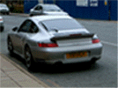
Resolution: How Much Is Enough? (cont…)
The picture on the right is fine for counting the number of cars, but not for reading the number plate

Slide 50
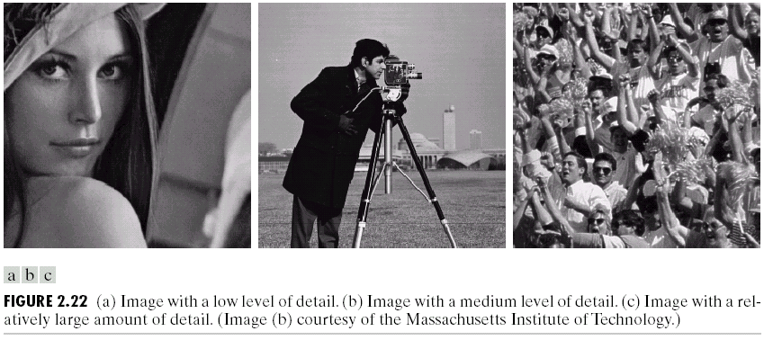
Intensity Level Resolution (cont…)
Images taken from Gonzalez & Woods, Digital Image Processing (2002)
Low Detail
Medium Detail
High Detail

Slide 51
Intensity Level Resolution (cont…)
Images taken from Gonzalez & Woods, Digital Image Processing (2002)

Slide 52
Intensity Level Resolution (cont…)
Images taken from Gonzalez & Woods, Digital Image Processing (2002)

Slide 53
Intensity Level Resolution (cont…)
Images taken from Gonzalez & Woods, Digital Image Processing (2002)

Slide 54
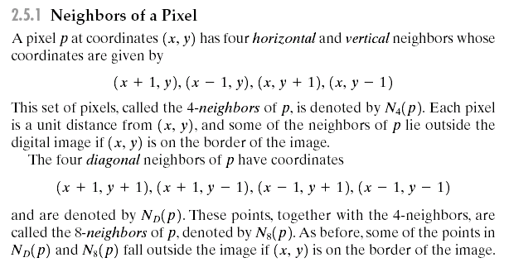
Some Basic Relationships Between Pixels

Slide 55

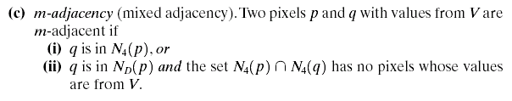
Some Basic Relationships Between Pixels
  Adjacency
    three types of adjacency:

Slide 56
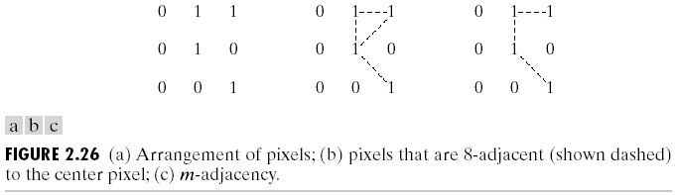

Slide 57
Some Basic Relationships Between Pixels
  Connectivity
    Two pixels p and q are said to be connected in S if there exists a path between them consisting entirely of pixels in S.
    For any pixel p in S, the set of pixels that are connected to it in S is called a connected component of S.
    If it only has one connected component, then set S is called a connected set.
  Regions
    Let R be a subset of pixels in an image.We call R a region of the image if R is a connected set.
  Boundaries
    The boundary (also called border or contour) of a region R is the set of pixels in the region that have one or more neighbors that are not in R.

Slide 58
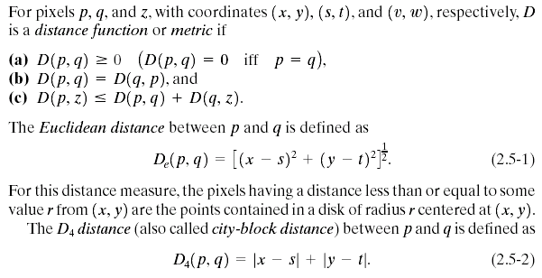
Some Basic Relationships Between Pixels
Distance Measures

Slide 59
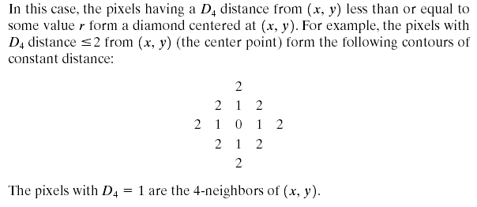
Some Basic Relationships Between Pixels

Slide 60
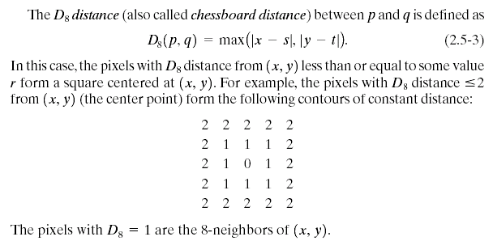
Some Basic Relationships Between Pixels

Slide 61
Summary
We have looked at:
  Human visual system
  Light and the electromagnetic spectrum
  Image representation
  Image sensing and acquisition
  Sampling, quantisation and resolution
  Basic relationship between pixels

